Slide 1
Error Handling and Debugging
CT4009
Week 5 – Lab Worksheet

Slide 2
Debugging…
Throughout CT4009 we have used the echo() function to track values
Here are a selection of practical tips that you can try to use when debugging your scripts.
ANOTHER BROWSER: Some problems are browser-specific. Try the code in another browser to see which ones are causing a problem.
ADD NUMBERS: Write numbers to the console so you can see which the items get logged. It shows how far your code runs before errors stop it.
STRIP IT BACK: Remove parts of code, and strip it down to the minimum you need. You can do this either by removing the code altogether, or by just commenting it out using multi-line comments: /* Anything between these characters is a comment*/
EXPLAINING THE CODE: Programmers often report finding a solution to a problem w hile explaining the code to someone else. ~ ERROR HANDLING & DEBUGGING SEARCH Stack Overflow is a Q+A site for programmers. Or us e a traditional search engine such as Google, Bing, or DuckDuckGo.
CODE PLAYGROUNDS: If you want to ask about problematic code on a forum, in addition to pasting the code int o a post, you could add it to a code playground site (such as JS Bin.com, JS Fiddle. com, or Dabblet. com) and then post a link to it from t he forum. (Other popular playgrounds include CSSDeck. com and CodePen. com -but these sites place more emphasis on show and tell.)
VALIDATION TOOLS: There are a number of on li ne validation t ools t hat can help you try to find errors in your code:
JAVASCRIPT http://www.jslint.com or http://www.jshint.com
JSON http://www.jsonlint.com
JQUERY There is a jQuery debugger plugin available for Chrome which can be found in the Chrome web store.
[by Jon Duckett..JavaScript & JQuery : interactive front-end Web development]
Notes:
Last week I was using the wrong email address which really throws you for a while. How many times as the error been a simple ‘;’ or a misspelt word??

Slide 3
PHP & MySQL Error handling…
We have already introduced;
die();
mysql_error() in our code.
From PHP & MySQL ULLMAN – Error Handling and Debugging CH6 (2nd Ed.)…

Slide 4
Purpose of this lab…
In this lab we are going to introduce an error handler which can display different messages depending on the state of the ‘LIVE’ flag.
First we write a handler called handle.inc.php
Then we write a simple php file to test the error handler
Once you are sure all is working as it should modify RegistrationDAO.php to incorporate handle.inc.php in the include file from last week.

Slide 5
Usual pre-coding setup…
Remember to establish your folders in;
N DRIVE: CT4009Sem2Week5
Same folder name in Cpanel under the public_html folder

Slide 6
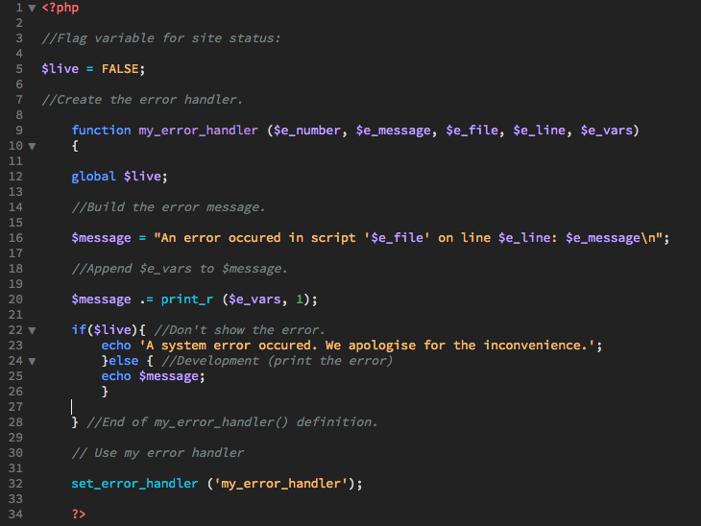
Note: the $live variable is used to toggle between development and a ‘live’ site.
In Dreamweaver, enter the code shown in a file called
“handle.inc.php” in the CT4009Sem2Week5 folder.

Slide 7
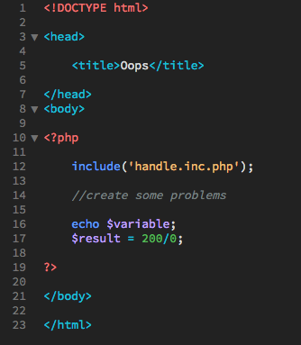
We include the handler PHP a new file called ‘error.php’, again in the CT4009Sem2Week5 folder.
Simple file with two fairly obvious errors;
Echo unassigned variable
Classic divide by zero.

Slide 8
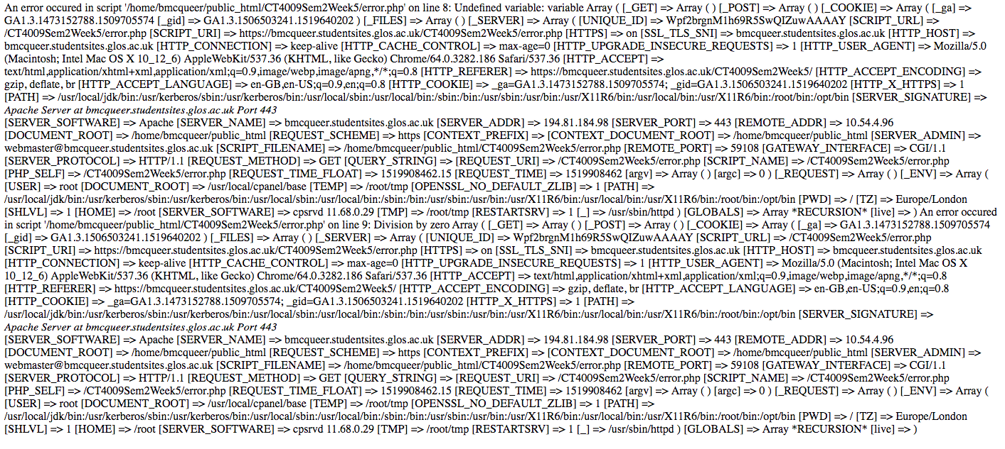
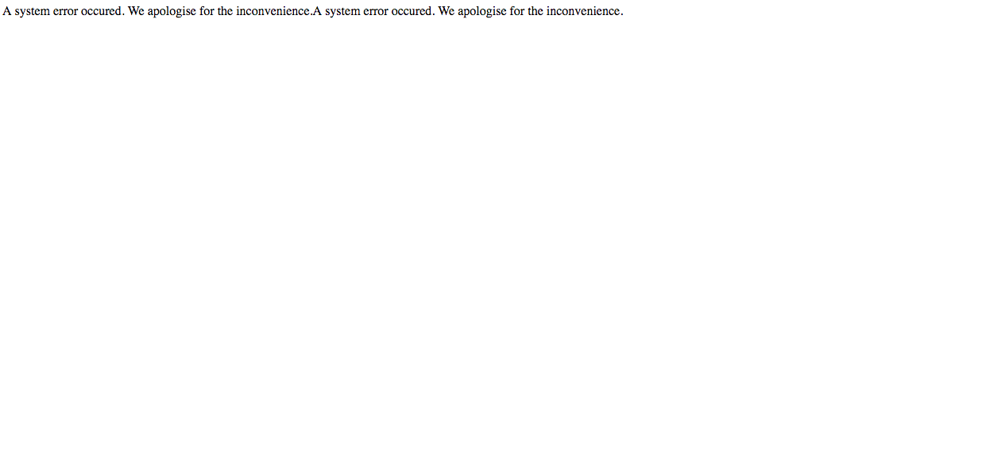
Verbose PHP error output $live=FALSE…
When you navigate to error.php you will see a verbose output.
When you toggle the $live variable to “TRUE” and refresh the error.php you should see a very limited output.
This is called error handling.
Very limited PHP error output $live=TRUE…

Slide 9
Homework…
Labwork…
This is also a catch-up session. If you haven’t complete previous week exercises, complete it now.
Experiment with error handling and the Flogger site
This will involve putting your ‘handle.inc.php’ in your Week4 include folder and putting an additional include in your userRegistrationDAO.php file.
Please start to investigate sessions and cookies.

